Slide 1

Class 4:
Communications
Modules
CERTIFICATON
COURSE
Level 1 Professional

Slide 2
Welcome!
Please introduce yourself in the chat with:
First Name
Organization Name
Your title
Instructor Name: Kimberly
Org Name: DonorView
Title: Customer Success Trainer
About me: I’ve been working with DonorView for three years and prior to that I was a DonorView user for a free medical clinic. I have about 15 years of non-profit experience in a variety of industries including social services, environmental causes, and the performing arts.

Slide 3
What are your
goals for
today’s class?
Answers:

Slide 4

DonorView Certification
Develop your database skills
Apply knowledge to day-to-day
operations and strategic plans
Increase efficiency and effectiveness
Increase fundraising

Slide 5
DonorView Certification
Level 1 Professional – Fundraising Fundamentals
Class 1 – CRM Module
Class 2 – Fundraising Module
Class 3 – Events Module
Class 4 – Communication Modules (Email, Texting & Surveys)
Level 2 Advanced Professional – Specialty Fundraising
Class 5 – Membership Module
Class 6 – Auction Module
Class 7 – Peer to Peer Module
Class 8 – Volunteer Module
Level 3 Expert – Strategy, Planning, and Donor Engagement
Class 9 – Donor Engagement
Class 10 – Key Performance Indicators
Class 11 – Fundraising Strategy
Class 12 – Annual Fundraising Plan

Slide 6
Topics in Class 4 – Communications
Email Marketing Module
Direct Mail and Email
Texting Features
Survey Module
Communications Strategy & Plan

Slide 7
Steps to Fundraising Success
Success!
Review
Actions
Goals
Strategy
Vision

Slide 8
Email Marketing Module
Contacts
Templates
Campaigns
Overview
Auto Responders
Best Practices

Slide 9
Direct Mail/Email
Filtering Lists
Mail Merge Letter Templates
Appeals and donor engagement

Slide 10
Texting Features
Text Messaging Activity
Text to URL from Forms
Direct Text Messages

Slide 11
Survey Module
Contacts
Survey/Forms Lists
Survey/Forms Results
Overview

Slide 12
Creating a Communications Strategy and Plan
Branding
Objectives
Audience
Content
Channels
Calendar
Outcomes

Slide 13
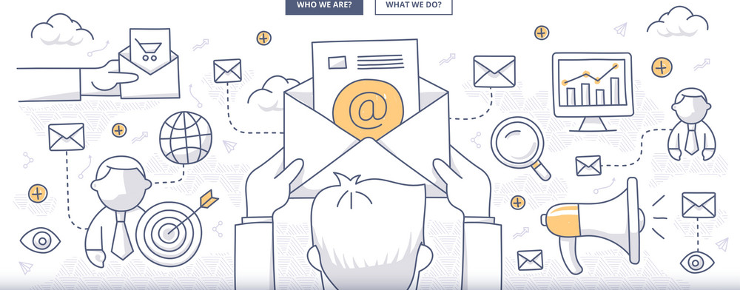
Email Marketing

Slide 14
Email Marketing - Contacts
New Lists
Managing Lists
Managing Contacts
Join My Mailing List
Widget
Link

Slide 15
Widget ____
Link ____
Both ____
Neither ____
Email List Sign Up
Do you use the widget, the link, both or some other method?

Slide 16
Email Marketing - Templates
Pre-designed
New
Editing
Design
Elements
Layout
Aesthetics

Slide 17
Templates
Questions:
Any questions about editing templates before we proceed?

Slide 18
Email Marketing - Campaigns
Recipients
Customize template
Test, send, schedule
Archive

Slide 19
Email Marketing - Overview
Snapshot
Email Delivery
Link Performance
Monetization
Campaign Trends

Slide 20
Email Marketing - Autoresponders
Identifying list categories
Customizing templates
Creating a drip campaign

Slide 21
Email Marketing – Best Practices
Quality list
Sender identity
Engaging and relevant content
Deliverability factors
Analyze to improve
Email verification service
Private IP address

Slide 22
Email Marketing
Questions:
Any questions about email marketing before we move on?

Slide 23
15 Minute Break

Slide 24
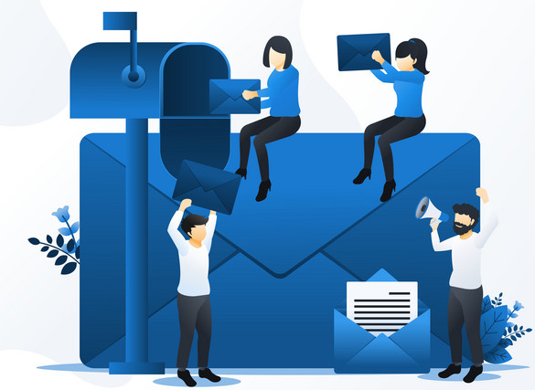
Direct Mail/Email

Slide 25
Direct Mail/Email – Filtering Lists
Identify the appropriate grid for purpose
Add filters to produce data
Clean data as needed for method
Adding categories

Slide 26
Direct Mail/Email – Mail Merge Letters
Creating and editing
Identifying the merge fields
Response forms
Paper
Online Donation Form
Appeals and source codes
Split tests

Slide 27
Direct Mail/Email – Appeals & Engagement
Special appeals
Annual appeals
End of year tax letters
Volunteer thank you
Donor engagement
Cultivation

Slide 28
Direct Email Feature
Must be activated
For quick messages – not marketing
Can include small attachments
Be respectful of “unsubscribes”
Tracked with Email Marketing Tab

Slide 29
Ideas:
Direct Mail/Email
Do you have any other examples of how your organization used direct mail or email for fundraising?

Slide 30

Texting

Slide 31
Texting – Text Messaging Activity
1000 messages
Text 2 URL
Message Type
Set up Error Message

Slide 32
Texting – Form Text-2-URL
Preview and Publish
Edit messaging

Slide 33
Texting – Direct Texts
Permission - Invite to subscribe
Forms
JMML
Text Message Lists
Opt-Out
Mobile phone default for text messaging
From grids

Slide 34
Texting
Questions:
Any questions or comments about text messaging before we move on?

Slide 35

Surveys

Slide 36
Surveys – Survey/Forms Lists
Polls
Surveys
Internal
External
Survey/Poll Categories
Emailed
Question Types
Adding Logic
Sensitive Data

Slide 37
Surveys – Surveys/Forms Results
Summary
Detail
Short Form
Long Form
Drill Down

Slide 38
Surveys – Contacts & Overview
Only necessary for emailed surveys
Same functionality of Email Marketing

Slide 39
Comments:
Surveys
How has your organization used the Survey Module? Did any surveys reveal anything surprising?

Slide 40

Communication Strategy and Planning

Slide 41
Strategy - Branding
Establishes who you are
Recognizable
Creates relationships
More than visual identity
Connected to vision, mission and values
Know your audience
Create a guide

Slide 42
Branding
YES
NO
Does your organization have a formal brand guide?
Comments:

Slide 43
Strategy – Conceptual Objectives
Motivate
Share knowledge
Persuade
Entertain
Create demand
Brand awareness
Complete transaction
Generate interest
Strengthening narrative

Slide 44
Strategy – Tangible Objectives (SMART)
Incorporate into fundraising strategy & plan
# New subscribers
Increase open rate
Increase response rates
Increase ROI
Increase followers/likes/shares
Financial goals
Website analytics

Slide 45
Plan - Audience
Segment Lists
Timing
Opt-in/out
Categories
Constituent
Email List
Custom multi-select fields

Slide 46
Plan - Content
Consistent messaging
Incorporates branding
Donor-centric
Transparency
Authenticity

Slide 47
Plan - Channels
Direct Mail
Email
Texting
Social media
Videos
Events
Website
Print articles/stories
New coverage
Outreach

Slide 48
Channels
Favorites:
What are your organizations favorite communication channels?

Slide 49
Plan - Calendar
Who is responsible?
What is being promoted/communicated?
When is it being sent?
Where is it being posted?
How is it being tracked/evaluated?

Slide 50
Strategy & Plan - Outcomes
Response Rates
ROI (or Cost/$ Raised)
Compare split tests
KPIs
Email open rates
Click through rates
Landing page conversion rate
Amplification (shares/followers)
Applause (likes/followers)

Slide 51
Comments:
Strategy & Plans
Any questions on creating a communications strategy and plan?

Slide 52
Review – Communications
Email Marketing Module
Direct Mail and Email
Texting Features
Survey Module
Communications Strategy & Plan

Slide 53
General
questions or comments?

Slide 54
Next Steps
Complete the post class survey
Take the quiz
Receive CEU Certificate
Class 5 – Fundraising Strategy & Planning Date

Slide 55
Thank You!
Copyright 2023. Do not distribute, copy, or share without express written permission.

